Slide 1
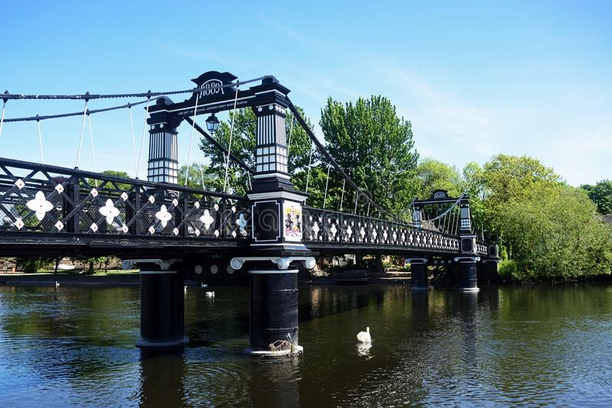
Writing: As writers, we will be expanding our writing toolkit by learning the wishing tale ‘The Three Billy Goats Gruff’. We are going to continuing to develop our sentence writing skills and we will begin to use conjunctions such as ‘and’ and ‘because’ to expand our sentences. We will also be working on making our sentences more interesting by painting a picture in the readers mind by using adjectives. |  | Music: As Musicians, we will be exploring the theme of ‘Water’ by developing our pitch skills. We will use our voices, movement and instruments to explore our change of pitch. | Art: As Artists, we will be expanding our artistic knowledge by learning printmaking techniques. We will creating repeated patterns by printing with objects such as leaves and sponges and creating a print inspired by The Three Billy Goats Gruff.
Maths: As Mathematicians, we will be continuing our development in numbers to 20. We will be exploring addition and subtraction by using a number of different methods including using number bonds and the ‘make 10’ method. | In Our Local Area Summer 1 Year One Curriculum Overview |  | Science: As Scientists, we will be looking at plants and trees in our local area. We will be learning the names of different plants and plant parts, and discuss what plants need to stay alive.
Phonics: We will continue with our daily Read, Write, Inc. Phonics lessons in order to develop our reading skills. Reading book changing days: Silva Class – Tuesdays & Fridays Thunburg – Mondays & Thursdays | P.E: In P.E this term we will be exploring athletics. We will be developing skills required in athletic activities such as running at different speeds, changing direction, jumping and throwing. We will engage in performing skills and measuring performances. Please note one session per week will be taught by Burton Albion Community Trust. Thunburg P.E days: Monday & Thursday Silva P.E days: Tuesday & Thursday |  | History: As historians we will be exploring the wonderful Burton Upon Trent and looking at how our town has changed over time. We will be then exploring the development of factories and how this has impacted how toys have changed over time.
PSHE: In PSHE this term we will be discussing differences between us as individuals and also discussing different family settings. We will also be bringing in our scientific knowledge by discussing how children grown and change and learning names for different body parts. Parents can view the materials to be taught on Thursday 5th May 2pm in the school hall. |  | Computing: In Computing, we will use digital literacy skills to store and receive information in order to create a new front cover for the story ‘The Three Billy Goats Gruff’. | R.E: In R.E this term we will be exploring Hinduism and Hindu festivals such as Diwali, Onam and we will explore Hindu celebrations such as weddings.

